Slide 1
Analysis Model

Slide 2
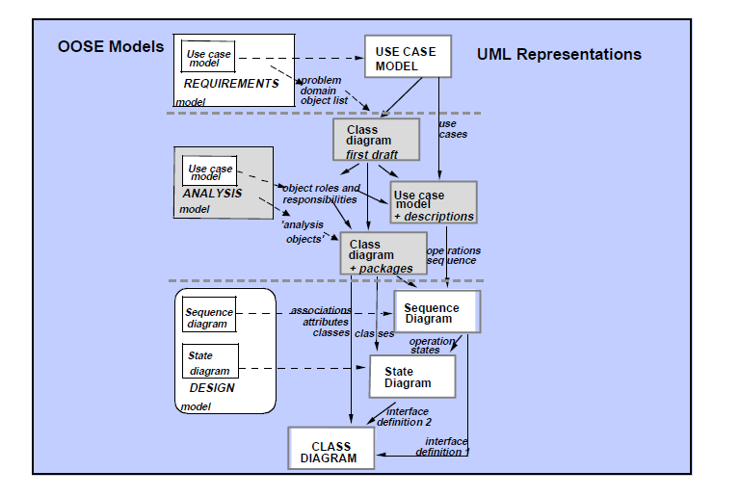
OOSE Models and UML Representations

Slide 3
Analysis Model Inputs and Outputs
Inputs
Use cases and use case model
Problem domain object list
Outputs
Class roles and responsibilities
Use case description in terms of classes and operations
Complete analysis model

Slide 4
Analysis Model
When the requirement model has been developed, and often also signed up by the customers, we can focus on the structuring of the system by developing the analysis model.
The aims is to create a good platform for the system and also to form the basis of the design
Developing the analysis model really entails distributing the behavior specified in the use case description among the objects in the analysis model
It should be stated explicitly which object is responsible for which behavior in the use case
Describe the system using three different types of object:
Entity classes(object)
Control classes(object)
Interface classes(object)

Slide 5
Roles of Classes(objects) in OOSE

Slide 6
Interface Classes(Objects)
All functionality specified in the use case description that is directly dependent on the system environment is placed in interface objects
Actors communicate with the system through these objects
The task is to translate the actor’s input to the system, into events in the system, and to translate these events into something which is presented to the actor
Having identified interface objects, it will be easy to modify an interface in the system
This is a common situation that must be manageable

Slide 7
Strategies in finding Interface Classes(Objects)
Identified from the system interface description accompanying the requirement models
Start from the actors
Read the use case description and extract the functionality that is interface-specific

Slide 8
Example – Use Case Decription Use Case Returning Item
When the customer returns a deposit item, it is measured by the system. The measurements are used to determine what kind of can, bottle or crate has been deposited.
If accepted, the customer total is incremented, as is the daily total for that specific item type.
If the item is not accepted, the lights for “NOT VALID” is highlighted on the panel.
When the customer pressed the receipt button, the printer prints the date.
The customer total is calculated and the following information printed on the receipt for each item type:
Name
Number returned
Deposit value
Total for this type
Finally the sum that the customer should receive is printed on the receipt.

Slide 9
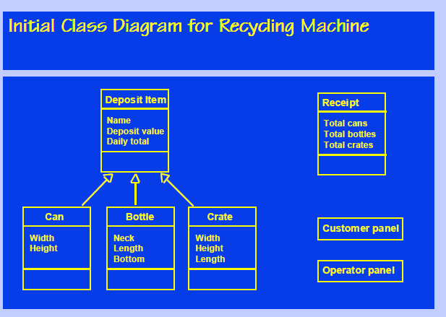
Case Study : Recycling Machine

Slide 10
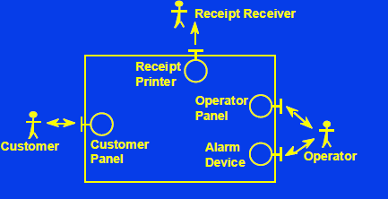
Interface Classes

Slide 11
Associations between Interface Classes
Interface objects must know of each other to be able to solve certain task
Acquaintance association
Solid directed line (uni directional)
Having name and cardinality
Cardinality: Says how many instances can be associated

Slide 12
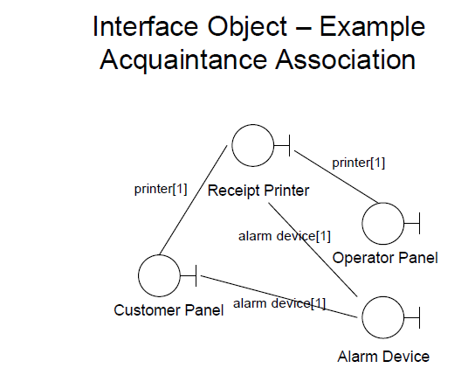
Interface Object

Slide 13
Entity Class(Object)
Used to model the information that the system
will handle over a longer period of time
The information should be kept even if the use
case has been complete
Also used to allocate the behavior that naturally belongs to this information
Entity objects use attributes to store information

Slide 14
Strategies in finding entity objects
Identified from the use case description
Most are found early and obvious
It’s easy to find entity object, but more difficult to
Identify its operations and attributes
In normal case, operations are not identified in the analysis
model (but later in the design model)
Typical operations that must be offered by an entity object:
creating and deleting the entity object
storing and fetching information
behavior that must be changed if the entity object is changed

Slide 15
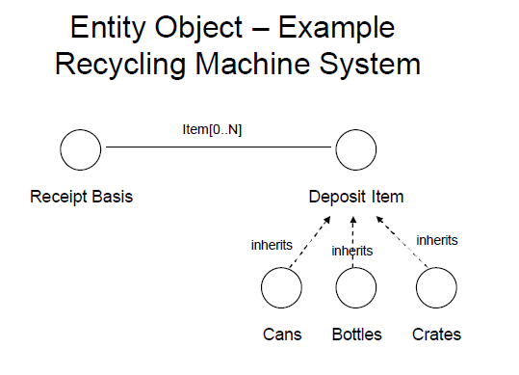
Example – Entity Objects

Slide 16
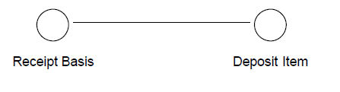
Association between entity object
Communication association
The entity object contact another entity object and asks for information about something

Slide 17
Control Object
Used to model behavior that is not naturally placed in either of another two objects (interface and entity)
Usually needed in more complex use cases
Typically acts as glue which unites the other objects
Type of functionality placed in the control objects are
transaction-related behavior, or
control sequences specific to one or a few use cases, or
functionality that separates the entity objects from the interface objects.

Slide 18
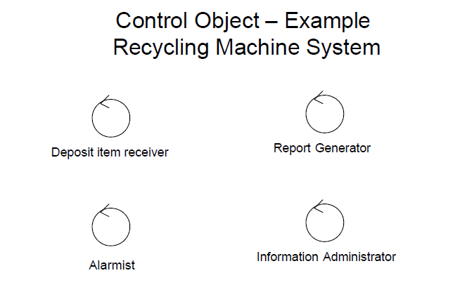
Example – Control Objects

Slide 19
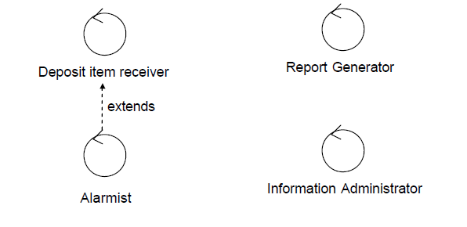
Working with analysis objects

Slide 20
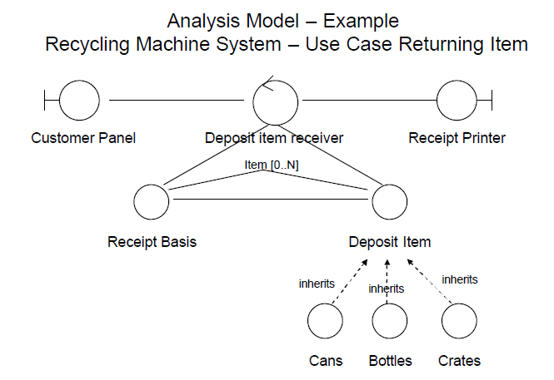
Recycling Machine system

Slide 21
Subsystem
To get a clear overview of the system, the objects identified need to be placed in groups called subsystem
The tasks is to package the objects so that complexity is reduced.
The lowest level of subsystem called service Packages.

Slide 22
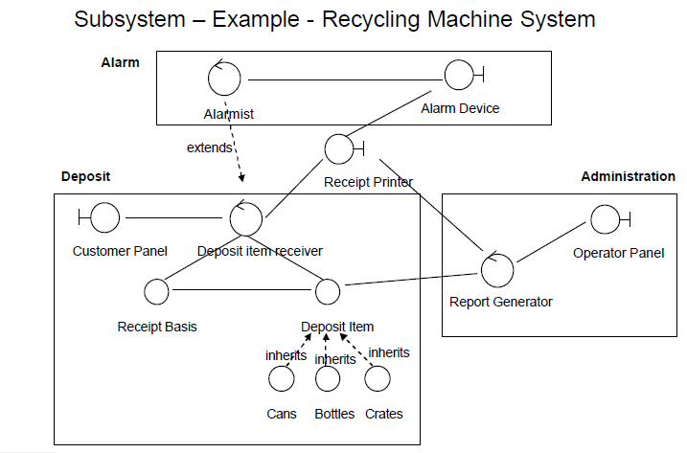
Example : subsystem

